Slide 1
Motivational Modelling
Material for SWEN90016 students
August, 2020

Slide 2
What is motivational modelling?
A method to understand a problem that is easy to connect with requirements and designs
Based on research in agent-oriented software engineering and influenced by design thinking
Three stage process
Do/be/feel™ elicitation
Converting 4 lists into a single (high-level) diagram
Ongoing checking throughout a project

Slide 3
Family Artifacts Register Motivational Model COMP3002 project in 2019

Slide 4
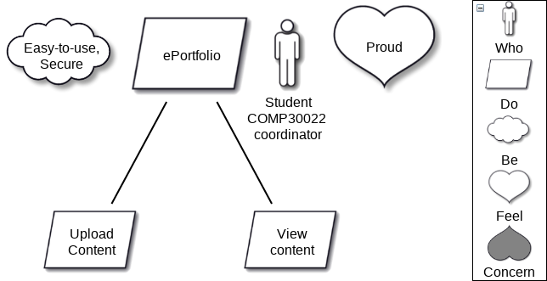
A simple ePortfolio Motivational Model for COMP30022 in 2020

Slide 5
Motivational models for you
Expand the model to represent your understanding of the problem and to reach agreement with the development team
Fill in the do/be/feel template
The COMP30022 will lead the process

Slide 6
Do/be/feel Template
Who | Do | Be | Feel | Concerns

